Slide 1

Solo Practitioner, You are not alone.

Slide 2
Current Problem
Mrs. Gilligan is a hard-working attorney. She is a loving wife, a wonderful mother of two, and is a new grandmother to two twin baby boys.
Between her hectic solo trust and estates practice and her growing family, Mrs. Gilligan doesn’t have a minute to herself.
So I asked….
“Mrs. Gilligan, what is something you do a hundred times a week that you wish someone would take off your plate?“
She answered..
“THIS DAMN FORM!”

Slide 3
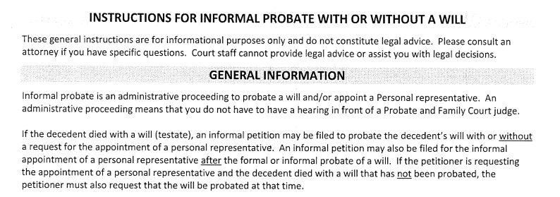
The “damn form”

Slide 4
The Problem
Current Solutions
It is filled with mundane yes or no questions
It contains complex instructions and difficult to understand explanations
It is seven pages long and decides which of two petitions the client needs
Mrs. Gilligan spends a ton of time doing them.
Beg a court clerk for help
Ask Mrs. Gilligan for help
Do nothing and hope for the best

Slide 5
My Solution
Create a bot to:
1. Guide the client through the questions
2. Offer explanations of legalese terms and complex steps
3. Populate a one-page sheet for the client to give to Mrs. Gillian that will explain how she needs to proceed based on the client’s answers

Slide 6
Projected Outcomes
Better client understanding of the material
Less work for Mrs. Gilligan
Take on more clients
Focus on more complex issues
Be happier

Slide 7
Stake Holders: Who has an interest in the outcome?
Mrs. Gilligan
She will be the primary beneficiary of the project. The results will tie almost directly to her satisfaction and time.
Suffolk University LIT Lab
Suffolk will essentially own the product created.
Me (Patrick Genovese)
I want to create a good product
MA Probate Court
If the product helps clients and pro se litigants know which petition they need, the courts can cut down on some of their overflow.

Slide 8
Users
First: Mrs. Gilligan’s clients.
Next: All Massachusetts citizens in need of appointed personal representatives

